Slide 1
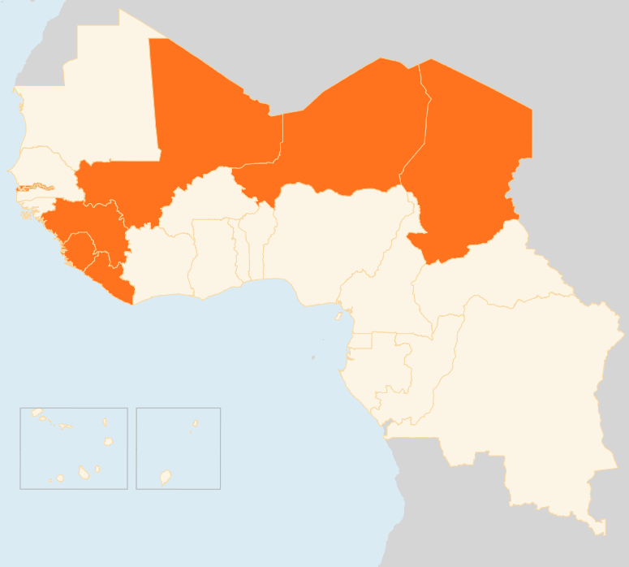


23 – 29 June 2015
CHAD
11 KILLED IN POLICE RAID
On 29 June, 11 people (five police officers and six suspected insurgents) were killed during a police operation against suspected Boko Haram elements in N’Djamena. Police seized several suicide belts and other explosive devices. The operation comes two weeks after twin attacks targeting police offices in the capital killed 34 people. Separately, in a controlled explosion, police destroyed a vehicle laden with explosives in N’Djamena’s central market.
SECURITY MEASURES TIGHTENED AFTER ATTACKS
Following the 15 June attacks, Chadian authorities have introduced a raft of security measures including the issuance of new passports and IDs. Wearing of full-face turbans and veils as well as having tinted car windows have already been outlawed. Boko Haram is suspected to be behind the recent attacks in Chad and Niger, whose armies, alongside those of Cameroon and Nigeria, have been battling the militants. Around 1,8 million people have been displaced in the region following the Boko Haram insurgency. In Chad, an estimated 48,000 people have been uprooted.
LIBERIA
FIRST EBOLA CASE IN SEVEN WEEKS
On 30 June, Liberia announced the first Ebola death since the outbreak was declared over in the country on 9 May. The deceased, a 17 year-old boy, was from a village in Margibi County located in the east of the capital Monrovia. Response by authorities and humanitarian partners in the area and the tracing of contacts are underway. The government and health partners have recently raised concern over the possible resurgence of Ebola due to increased unconfirmed reports of suspected cases in the past weeks.
MALI
NEW ATTACKS IN SOUTH AND EAST
On 28 June, armed attackers raided and destroyed government buildings in Fakola area close to the border with Côte d'Ivoire. On 27 June, militants attacked a military camp in Nara area near Mali’s border with Mauritania. Three soldiers and nine assailants were killed during the attack. The incidents happened a week after northern Mali’s main Tuareg rebels signed a peace agreement with the government. Ansar Dine insurgents claimed responsibility for the attacks, according to media reports.
NIGER
5 KILLED IN VILLAGE RAID
Five people were killed and four others injured on the night of 24 June in an attack on a village near Bosso town in the southeast of Niger close to the border with Nigeria. The attackers, suspected to be Boko Haram militants, also torched more than 100 homes and 100 motorcycles as well as the local market. According to initial estimates some 1000 people have been affected. A Government-led assessment is ongoing to evaluate needs and both food and NFIs have been distributed to the affected population.On the night of 17-18 June, armed attackers killed 38 people during raids on three villages in the same area.
EVD REGIONAL
CURFEW IN SIERRA LEONE
Liberia reported its first EVD case in seven weeks on 30 June. As of 25 June, three new confirmed and six suspected cases were reported in Guinea, where hostility towards health workers still hampers efforts to curb Ebola. In Sierra Leone, a 21-day daytime curfew has been imposed in parts of Kambia and Port Loko districts where EVD cases continue to be reported. In the week to 21 June, a total of 20 cases were reported in Guinea and Sierra Leone.
MALI
NEW ATTACKS IN SOUTH
AND EAST
NIGER
5
KILLED IN VILLAGE RAID
CHAD
11
KILLED IN POLICE RAID
EVD REGIONAL
LIBERIA
CURFEW IN SIERRA LEONE
1
FIRST EVD CASE SINCE MAY
Creation date: 01 July 2015
Map data sources: UNCS, DevInfo, OCHA.
The boundaries and names shown and the designations used on this map do not imply official endorsement or acceptance by the United Nations

